Slide 1

Fundamentals of Data Structures using C++
Topic: Linked List
By
Ravi Kant Sahu
Assistant Professor
Lovely Professional University, Punjab

Slide 2
Introduction
A linked list (One-way list) is a linear collection of data elements, called nodes, where the linear order is given by means of pointers.
Each node is divided into two parts.
First part contains the information of the element.
Second part contains the address of the next node in the list.

Slide 3
Why Linked List?
Arrays: pluses and minuses
+ Fast element access.
-- Impossible to resize.
Need of Linked List
Many applications require resizing!
Required size not always immediately available.

Slide 4
Linked List Node
A singly linked list is a sequence of nodes.
next
struct Node
{
int data;
Node* next;
};
data
Node
∅
A
B
C
D

Slide 5
Linked List Start pointer
START
Node* START;
∅
A
B
C
D

Slide 7
Key Points
Linked list
Linear collection of nodes
Connected by pointer links
Accessed via a pointer to the first node of the list
Link pointer in the last node is set to null to mark the list’s end
Linked list contains a List Pointer Variable called START or NAME or Head, which contains the address of the first node.

Slide 8
Use a linked list instead of an array when
You have an unpredictable number of data elements
You want to insert and delete quickly.

Slide 9
Difference between Singly Linked List and Array

Slide 10
Types of Linked Lists
1. Singly linked list
Begins with a pointer to the first node
Terminates with a null pointer
Only traversed in one direction
2. Circular, singly linked
Pointer in the last node points
back to the first node
3. Doubly linked list
Two “start pointers” – first element and last element
Each node has a forward pointer and a backward pointer
Allows traversals both forwards and backwards

Slide 11
Traversing a Linked list

Slide 12
Traversing using 2-Pointers

Slide 13
Check whether the linked list contains Loop or not

Slide 14
Insert in a linked LIst
START
Ø
ITEM

Slide 15
DELETE from a linked LIst
START
ITEM
Ø
Node A
Node N
Node B

Slide 16
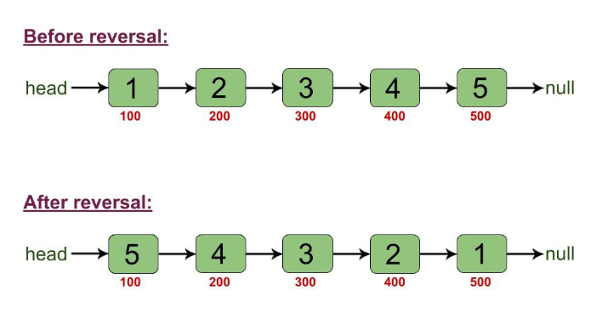
Reverse a linked LIst

Slide 17
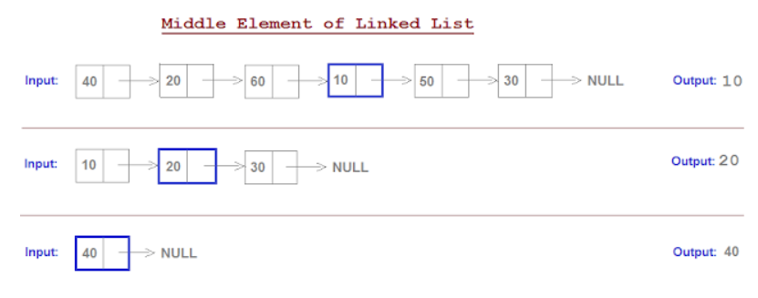
Middle element of a linked List using single loop

Slide 18
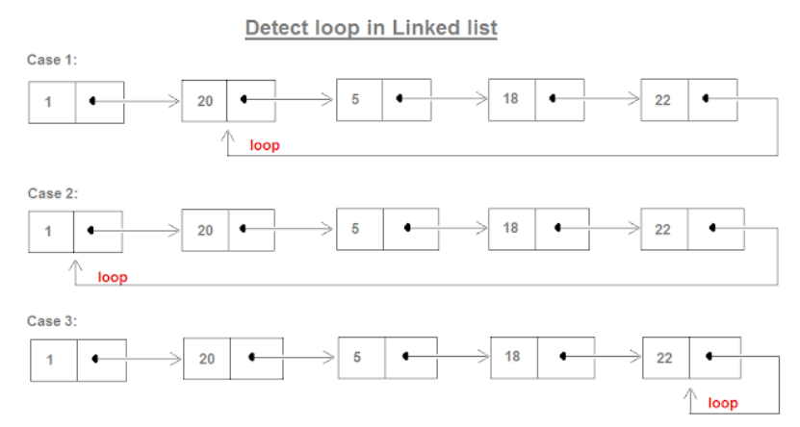
Detect the LOOP/ CYCLE in a linked LIst

Slide 19
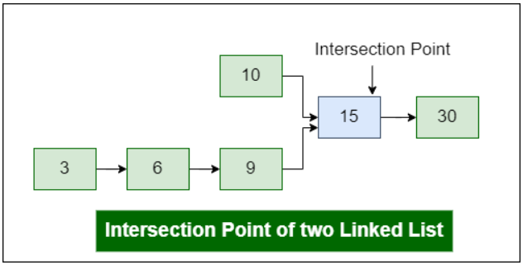
Find INTERSECTION of 2 linked LIst

Slide 20
Two-Way Linked list
START
END
BACK
X
X
INFO
FORW

Slide 21
Header Linked list
A header linked list which always contains a special node, called the header node, at the beginning of the list.
START
Ø
HEADER NODE

Slide 22
Header Linked list
Header linked list contains a special node at the top.
This header node need not represent the same type of data that succeeding nodes do.
It can have data like, number of nodes, any other data...
Header node can access the data of all the nodes in the linked list.

Slide 23
Types of Header Linked list
A Grounded header list is a header list where the last node contains the null pointer.
A Circular header list is a header list where the last node points back to the header node.
Note: Unless otherwise stated or implied, header list will always be circular list.

Slide 24
Grounded Header Linked list
START
Ø
HEADER NODE

Slide 25
Circular Header Linked list
START
HEADER NODE

Slide 26
Practice problem
Remove duplicates from a Sorted Linked List

Slide 27


Slide 28
Review Questions
Why we need Linked List?
What are the two different Fields in a node of linked list.
How Linked lists are different from Arrays?
Why Binary search is not possible in Linked list?
What is the difference between Circular Linked List and Doubly Linked List?

